Slide 1
Intern Exit
Presentation
Chengming Li

Slide 2
Agenda
About Me & Future Journey
Accomplished Projects
Key takeaways
Acknowledgement
Q&A

Slide 3
About me
Chengming(Steven) Li
BS Electrical & Computer Engineering Degree at University of Colorado, Boulder
Will be MS Electrical & Computer Engineering student at University of California, San Diego
Here, at Eridan, RF Test Engineering Intern from June- Aug

Slide 4

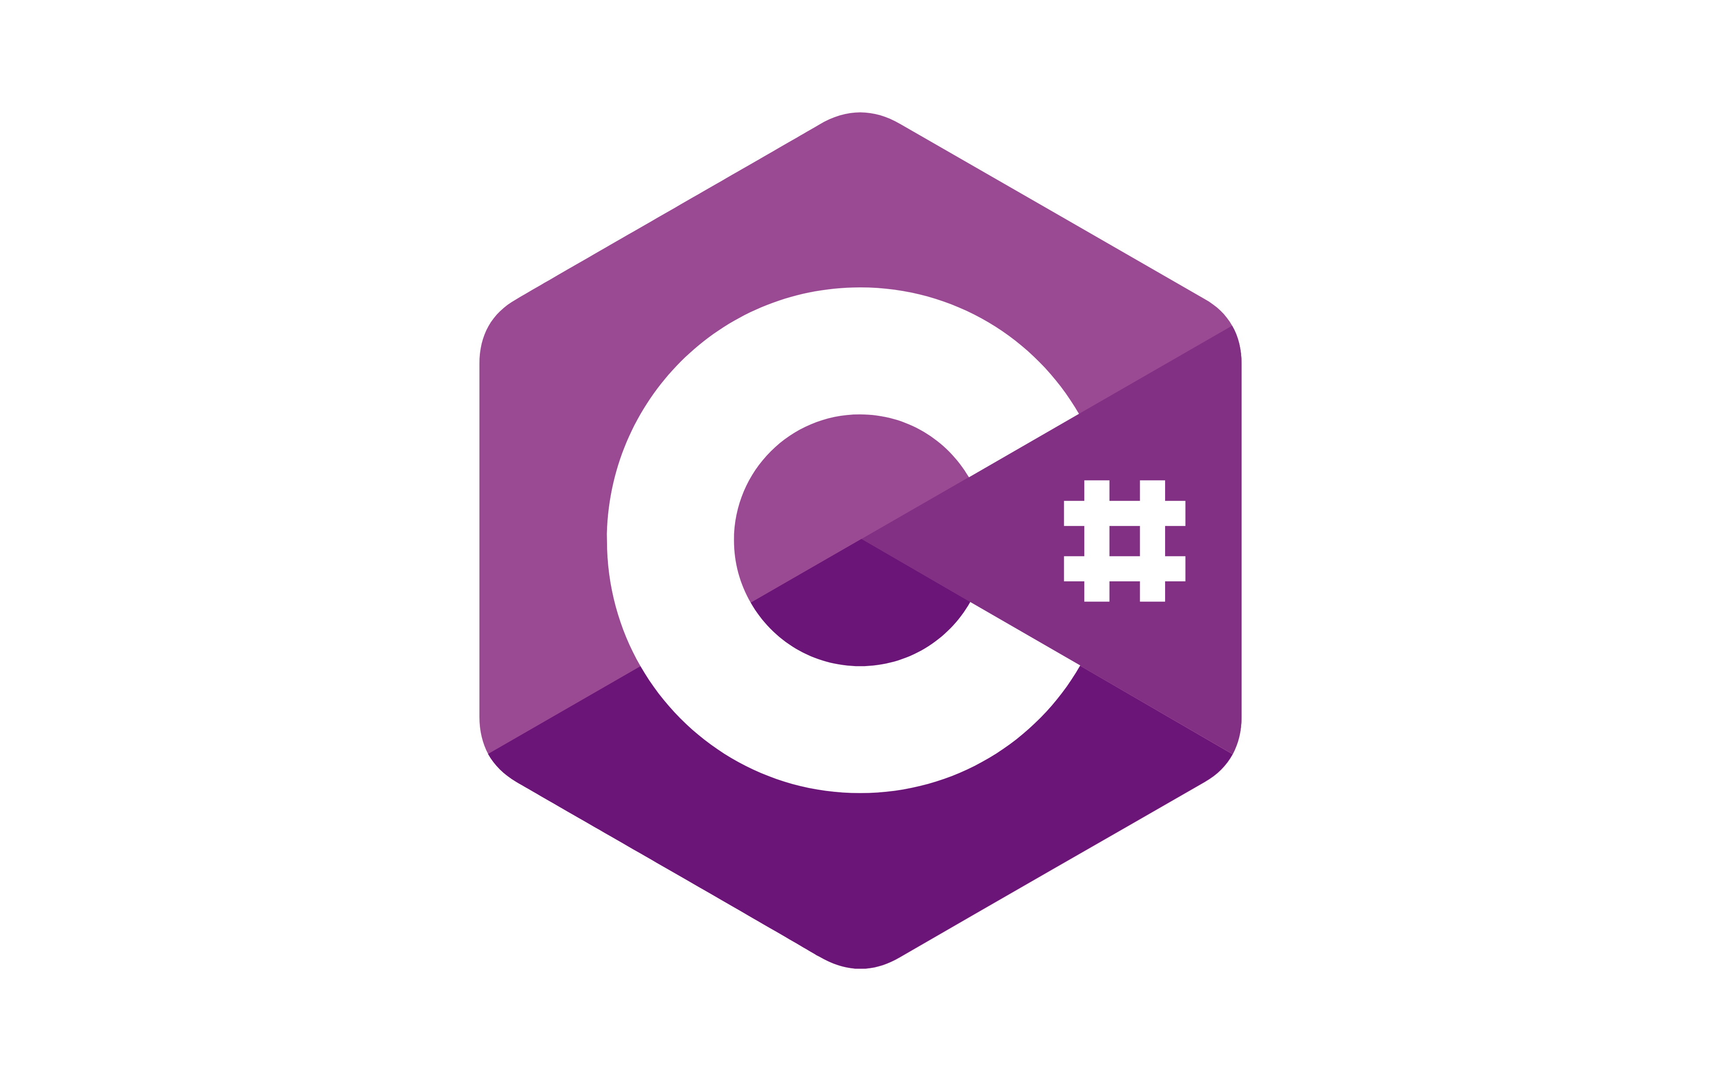

Accomplished Projects
pyEridanLab
The Problem? Why?
Cost of MATLAB License
From C# to Python
How to use DLLs in python

Slide 5
Accomplished Projects
pyEridanLab
The Solution -> How !?:
Cost of MATLAB License
Use C# and Python.
Open source,
Free to use.
From C# to Python
Use Dynamic Link Library (DLL)
.Net
pythonnet
How to use DLLs in python
Type hint files, .pyi
Import clr

Slide 6
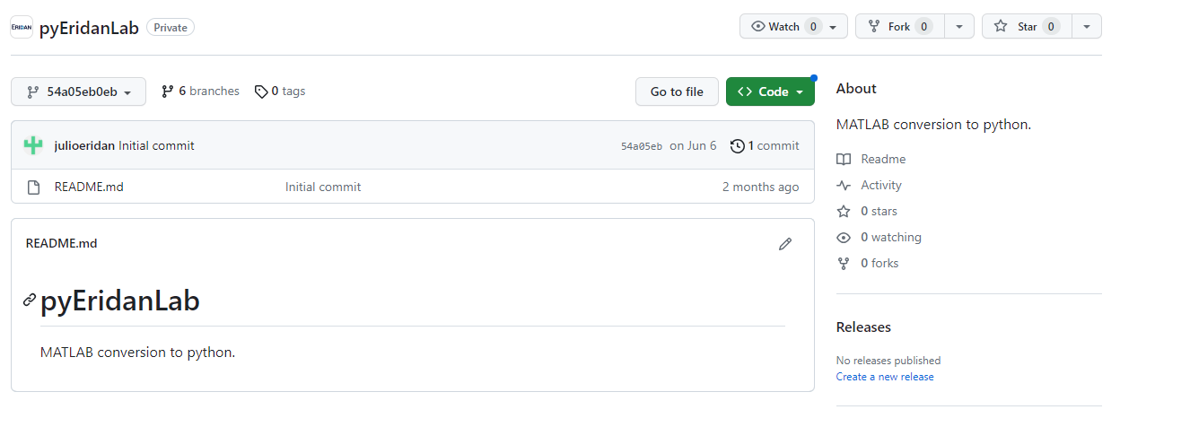
Accomplished Projects
pyEridanLab
What it looks like at the beginning

Slide 7
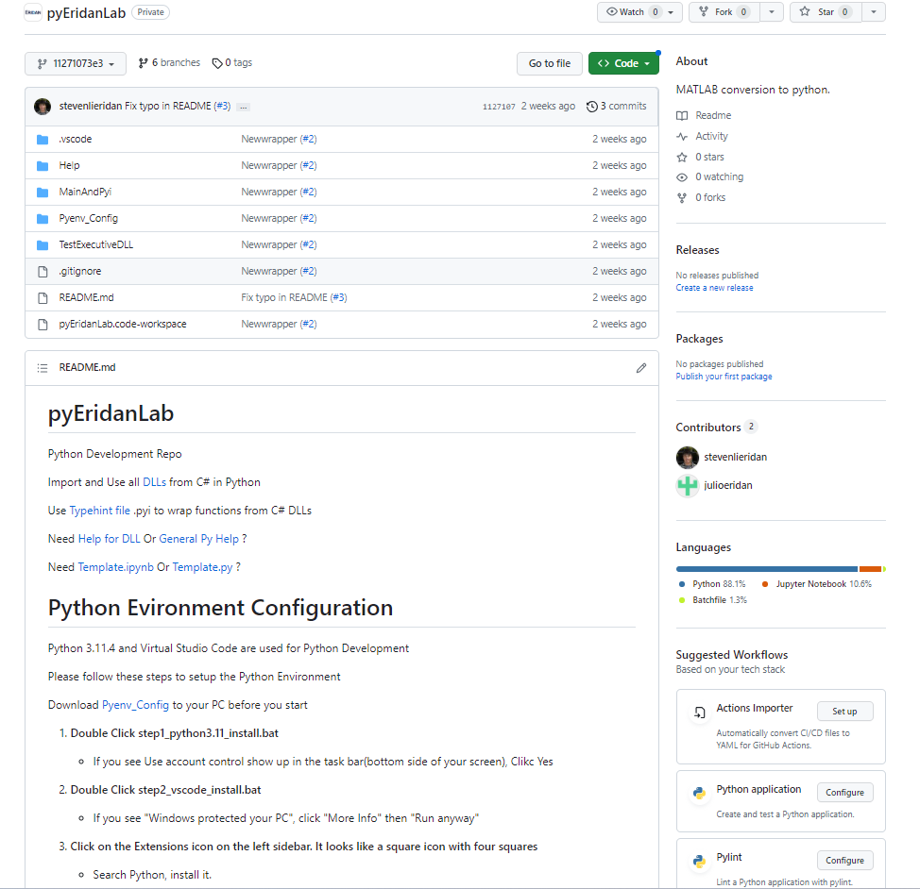
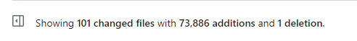
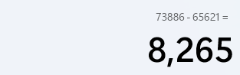
Accomplished Projects
pyEridanLab
After a month effort…
Ignore 65621 additions, which is dlls
8265 lines of code, wrap everything in C#

Slide 8
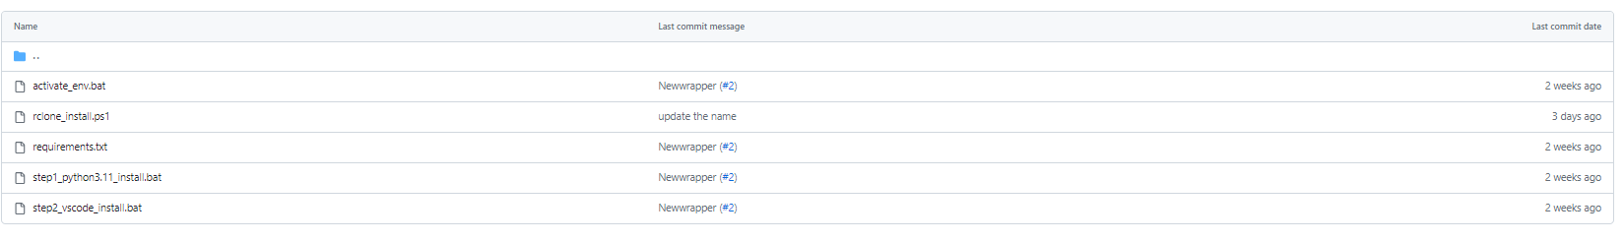
Accomplished Projects
pyEridanLab
Double click to install everything as you need

Slide 9
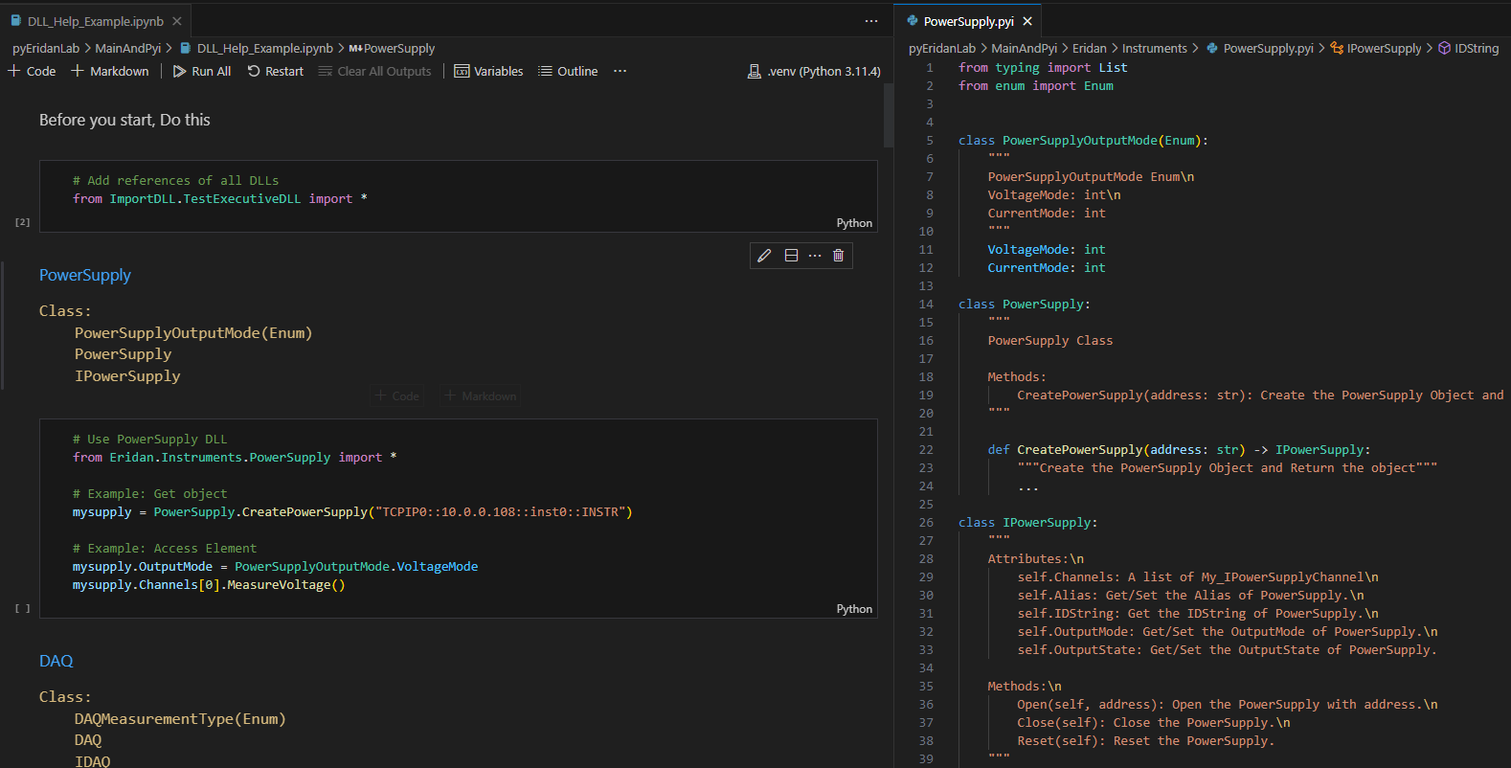
Accomplished Projects
pyEridanLab
Need help for DLLs usage? --> DLL Help Script!

Slide 10
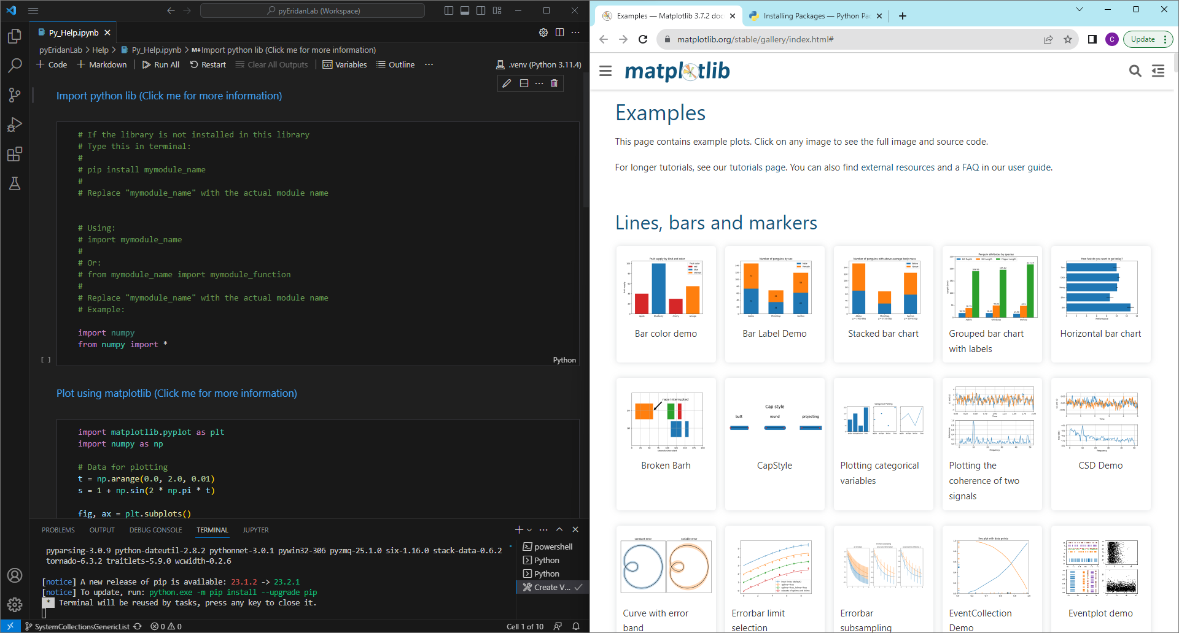
Accomplished Projects
pyEridanLab
Need help for Python usage? --> Python Help Script!

Slide 11
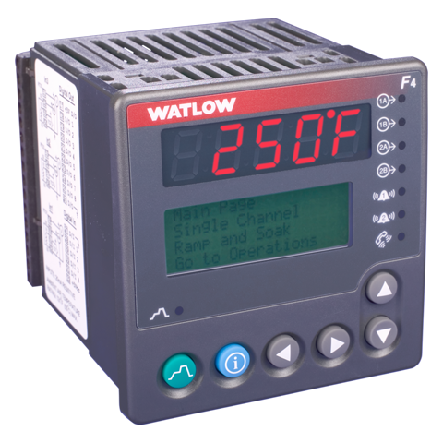
Accomplished Projects
2. Temperature Chamber
The Problem? Why?
Oscillation during the heating/cooling
How to know if there is an error in 30s
Whether the hardware switch is on
Whether it is going to the right direction
How to handle the overshooting

Slide 12

Accomplished Projects
2. Temperature Chamber
The Solution -> How !?:
Oscillation during the heating/cooling
AutoTune-off
How to know if there is error in 30s
Whether the hardware switch is on
Check if the temperature change after starting the program
Whether it is going to the right direction
Compare the delta between current temp and target temp
How to handle the overshooting
Make sure it converges for 30s

Slide 13
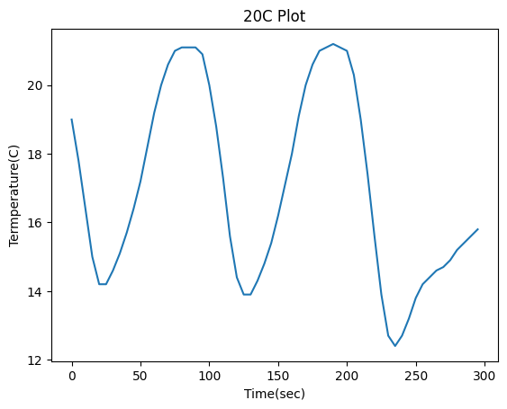
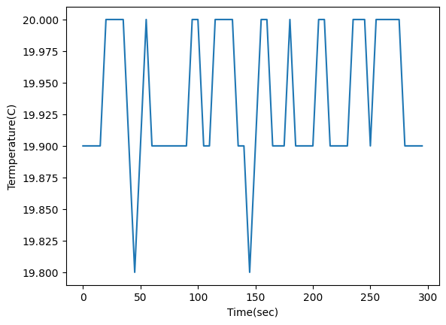
Accomplished Projects
2. Temperature Chamber
Before
After

Slide 14
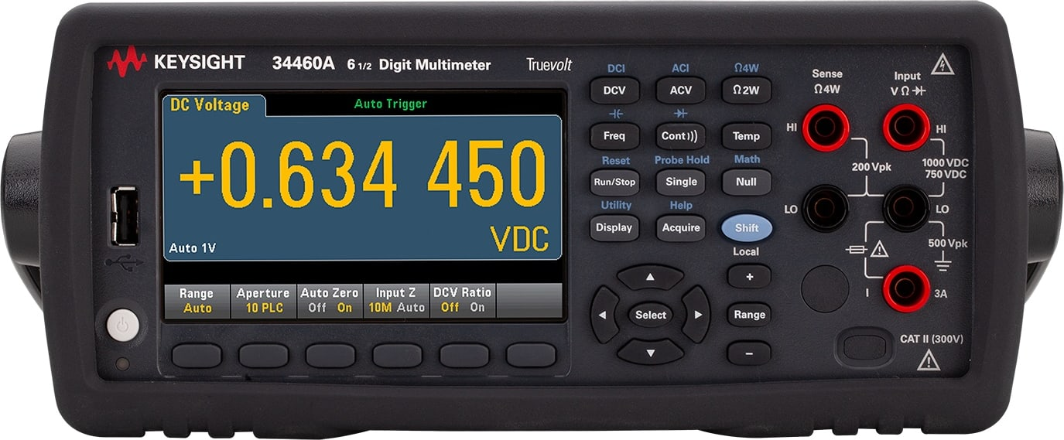
Accomplished Projects
3. Digital Multimeter
The Problem? Why?
Read Temperature from DMM
Different Models support different Thermo Probes

Slide 15
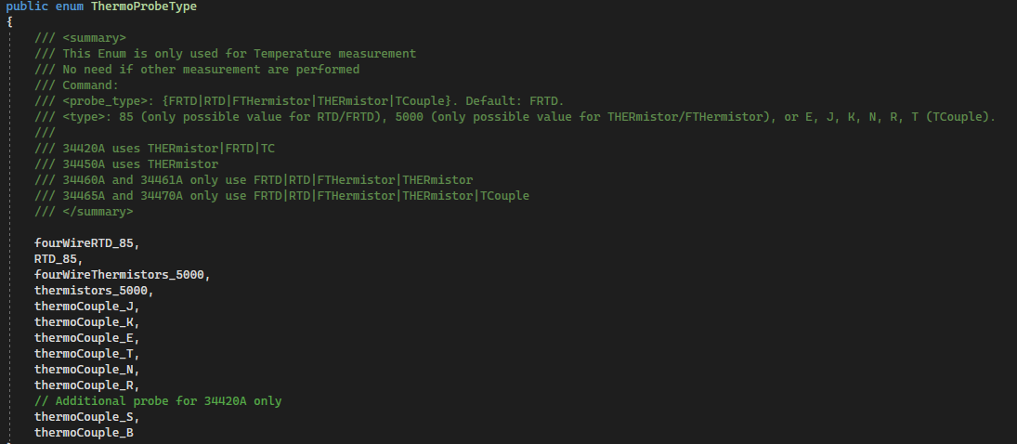
Accomplished Projects
3. Digital Multimeter
The Solution -> How !?:
Read Temperature from DMM
Create GetTemperature() Function in C#
Different Models support different Thermo Probes
“Switch” Statement to choose ThermoProbe for different models

Slide 16
Key takeaways
Be Proactive
Take the Responsibility
Try First
One Problem/Thing at a time
Be Precise/Easy to Understand
Marketing Requirements

Slide 17
What skills do I learned
C#
GitHub
Python Programming Practice
Instrument Interface
Batch Script
Vscode config
PID Control

Slide 18
Acknowledgement
Shawn
Julio
Tanner
Angel
Jason
Hala
Eridan

Slide 19

Q&A

